Slide 1
应用帧中继实现
广域网连接
Notes:
Purpose: This chapter provides a brief overview of Frame Relay operation. It also explains how to configure Frame Relay on a Cisco IOS device.
Timing: This chapter takes approximately 1.5 hours to present.
Note: This section has a laboratory exercise in which students configure a Frame Relay PVC on a serial connection. They will also configure Frame Relay subinterfaces.
Contents:
Objectives—This section explains what the student will be able to do at the end of this chapter.
Frame Relay Overview—This section describes how Frame Relay operates.
Configuring Frame Relay—This section describes how to configure Frame Relay on a Cisco IOS device.
Configuring Frame Relay Subinterfaces—This section describes how to configure Frame Relay subinterfaces.
Laboratory Exercise—Students will configure a Frame Relay PVC.
Summary—This section summarizes what was taught in the chapter.

Slide 2
本章目标
  通过本章的学习，您应该掌握以下内容：
  了解 Frame Relay 工作过程
  配置 Frame Relay
  配置 Frame Relay 的子端口
  查看 Frame Relay 信息
Notes:
Purpose: This figure states the chapter objectives.
Emphasize: Read or state each objective so each student has a clear understanding of the chapter objectives.
Transition: The next section presents an overview of Frame Relay.

Slide 3
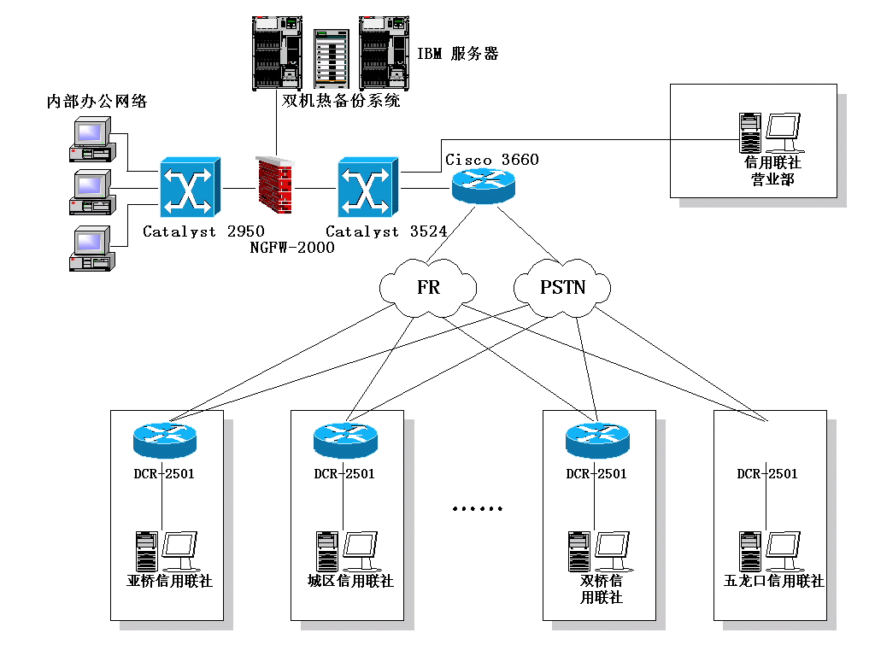
河南济源农联社改造建设

Slide 4
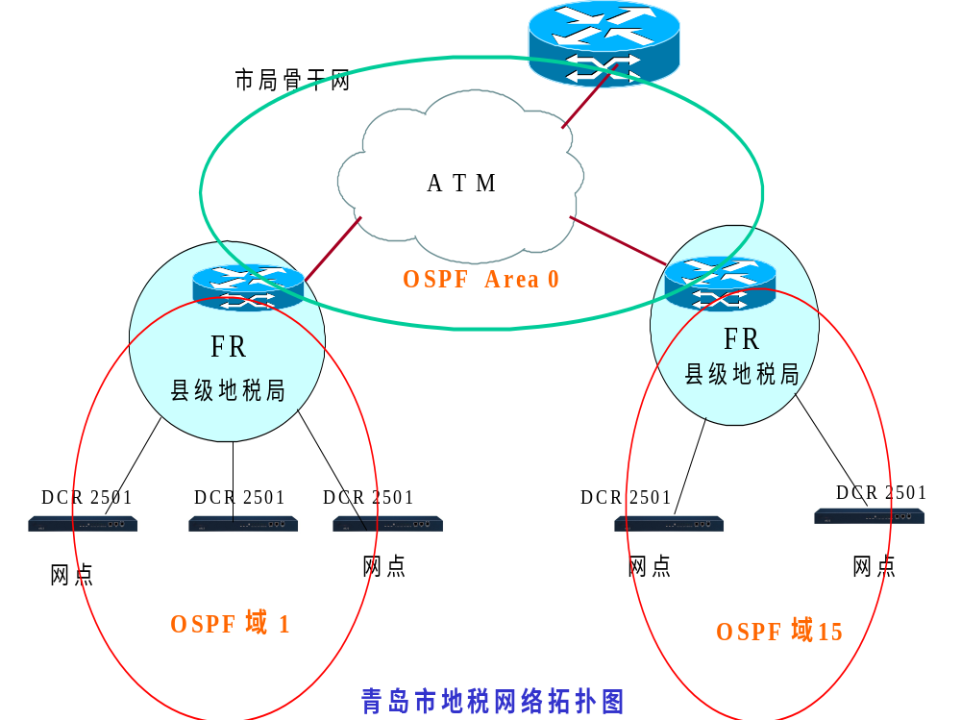
青岛市地税局应用案例

Slide 5
帧中继概述
是由国际电信联盟通信标准化组和美国国家标准化协会制定的一种标准。
它定义在公共数据网络上发送数据的过程。
它是一种面向连接的数据链路技术，为提供高性能和高效率数据传输进行了技术简化，它靠高层协议进行差错校正，并充分利用了当今光纤和数字网络技术。

Slide 6
帧中继的作用
帧使用DLCI进行标识，它工作在第二层；帧中继的优点在于它的低开销。
帧中继在带宽方面没有限制，它可以提供较高的带宽。
典型速率56K-2M/s内。
DLCI(数据链路连接标识):是用来标识路由器和帧中继交换机之间的逻辑电路的数字.

Slide 7


选择 Frame Relay 拓扑结构
Full Mesh
Partial Mesh
Star (Hub and Spoke)
Notes:
Purpose: This figure is a transition discussion to illustrate the need for subinterfaces. Now that students are familiar with the concept and configuring of Frame Relay, they are ready to consider the issues and solutions related to broadcast updates in an NBMA Frame Relay network.
Emphasize: Compare the different topologies described.
Explain that by default interfaces that support Frame Relay are multipoint connection types. This type of connection is not a problem when only one PVC is supported by a single interface; but it is when multiple PVCs are supported by a single interface. In this situation, broadcast routing updates received by the central router cannot be broadcast to the other remote sites.
Broadcast routing updates are issued by distance vector protocols. Link-state and hybrid protocols use multicast and unicast addresses.

Slide 8
全网结构：提供最大限度的相互容错能力；物理连接费用最为昂贵。
部分网格结构：对重要结点采取多链路互连方式，有一定的互备份能力。
类似于公路网
星型结构：最常用的帧中继拓扑结构，由中心节点来提供主要服务与应用，工程费最省

Slide 9
帧中继的前景
一种高性能，高效率的数据链路技术。
它工作在OSI参考模型的物理层和数据链路层，但依赖TCP上层协议来进行纠错控制。
提供帧中继接口的网络可以是一个ISP服务商；也可能是一个企业的专有企业网络。
目前，它是世界上最为流行的WAN协议之一，它是优秀的思科专家必备的技术之一。

Slide 10



Frame Relay 概述
DCE or
Frame
Relay Switch
CSU/DSU
Frame Relay works here.
  使用虚电路进行连接
  提供面向对象的服务
Notes:
Purpose: This figure provides a big-picture definition of Frame Relay.
Emphasize: Frame Relay is used between the CPE device and the Frame Relay switch. It does NOT affect how packets get routed within the Frame Relay cloud.
Frame Relay is a purely Layer 2 protocol.
The network providing the Frame Relay service can be either a carrier-provided public network or a network of privately owned equipment serving a single enterprise.
Make a clear distinction between DCE, DTE, and CPE.
Emphasize that Frame Relay over SVCs is not discussed in this chapter because it is not widely supported by service providers at this time. The service provider must also support SVCs in order for Frame Relay over SVCs to operate.
Note: In Cisco IOS Release 11.2, two traffic shaping features were introduced:
Generic (adaptive) traffic shaping
Frame Relay traffic shaping
Both of these features can be used to adjust the rate at which traffic is sent by the router. In addition, these features allow the router to throttle the traffic rate based on BECNs received from the Frame Relay switch. Neither of these features are discussed in this course. Frame Relay traffic shaping is discussed in the Building Cisco Remote Access Networks (BCRAN) course. Information on both can be found in Cisco documentation.

Slide 11
虚电路(Virtual Circuits):是指在确保通信的两个网络设备之间创建的逻辑电路。
永久虚电路(PVC，Permanent Virtual Ciruits):
指被永久建立起来的虚电路，一旦建立起来，就确定存在虚电路，无论情况下，带宽固定不变。
交换虚电路(SVC，Switched Virtual Ciruits)：是指有连接需求时动态建立起来的虚电路，数据传输完成后被拆除。适合数据量小时传输。

Slide 12
Frame Relay 与OSI
OSI 参考模型
Frame Relay
Application
Presentation
Session
Transport
Network
IP/IPX/AppleTalk, etc.
Data Link
Frame Relay
EIA/TIA-232, EIA/TIA-449, V.35, X.21, EIA/TIA-530
Physical
Notes:
Purpose: This figure compares Frame Relay to the OSI model.
Emphasize: The same serial standards that support point-to-point serial connections also support Frame Relay serial connections.
Frame Relay operates at the data link layer.
Frame Relay supports multiple upper-layer protocols.

Slide 13



Frame Relay 术语
PVC
DLCI: 100
LMI
100=Active
400=Active
DLCI: 200
DLCI: 400
Local Access
Loop=64 kbps
Local
Access
Loop=T1
PVC
Local Access
Loop=64 kbps
DLCI: 500
Notes:
Purpose: This figure provides an overview of terminology so that the student is prepared to understand the Frame Relay operation discussion.
The terminology used with Frame Relay varies by service provider. These are the commonly used terms.
Point out the local access loop and note that the local access rate is different than the rate used within the Frame Relay cloud.
The DLCI is of local significance, therefore, point out that the same DLCI can be used in multiple places in the network.
The autosensing LMI is a Release 11.2 or later feature.
Frame Relay connections are made using PVCs. The circuits are identified by the DLCI assigned by the service provider.
Reference: For more information on Frame Relay, including a Frame Relay glossary, refer to the Frame Relay Forum World Wide Web page:
http://www.frforum.com/4000/4003.html
This course does not discuss Frame Relay traffic flow issues. So terms like BECN, FECN and discard eligible are not discussed in this course. These terms are some of the terms that can be found in the Frame Relay Forum’s glossary. The BCRAN discusses Frame Relay traffic flow issues.

Slide 14
DTE：客户端设备，CPE，数据终端设备
DCE：数据通信设备或数据电路端接设备
虚电路（VC）：通过为每一对DTE设备分配一个连接标识符，实现多个逻辑数据会话在同一条物理链路上进行多路复用。
数字连接识别号（DLCI）：用以识别在DTE和FR之间的逻辑虚拟电路。
本地管理接口（LMI）：是在DTE设备和FR之间的一种信令标准，它负责管理链路连接和保持设备间的状态。

Slide 15
在网络中传输着各种信号，其中一部分是我们需要的（例如打电话的语音，上网的数据包等等），而另外一部分是我们不需要的（只能说不是直接需要）它用来专门控制电路的，这一类型的信号我们就称之为信令
信令分类主要有随路信令和公共路信令，随路信令就是说信令网就附在计算机网络或是电话网络上，不需要重新建一个网络，而公共路信令则是需要重新建设一个信令网（主要是在局端之间）

Slide 16
Frame Relay 地址映射
DLCI: 500
PVC
10.1.1.1
CSU/DSU
Inverse ARP or
Frame Relay map
Frame
Relay
DLCI (500)
IP
(10.1.1.1)
  从提供商那里得到本地的DLCI号
  建立目的地址和本地DLCI之间的映射关系
  frame-relay map ip 10.1.1.1 500 broadcast
Notes:
Purpose: This figure illustrates mapping the data-link connection identifier (DLCI) to the network layer address such as IP.
Emphasize: The DLCI is of local significance, therefore, point out that the same DLCI can be used in multiple places in the network. Frame Relay connections are made using PVCs. The circuits are identified by the DLCI assigned by the service provider.
Explain what Inverse ARP is used for. Static mapping can be configured instead of inverse ARP.

Slide 17
Frame Relay
DLCI: 500
PVC
10.1.1.1
x
CSU/DSU
LMI
500=Active
400=Inactive
DLCI: 400
PVC
Keepalive
Cisco 路由器支持的 LMI 标准:
  Cisco
  ANSI：ANSI标准T1.617d
  Q933A:ITU-TQ.933
Notes:
Purpose: This figure describes the Local management Interface (LMI) and shows the key standards.
Emphasize: Explain LMI.
Note: Other key American National Standards Institute (ANSI) standards are T1.606, which defines the Frame Relay architecture, and T1.618, which describes data transfer.
Other key International Telecommunication Union Telecommunication Standardization sector (ITU-T) specifications include I.122, which defines ITU-T Frame Relay architecture, and Q.922, which standardizes data transfer. Use of these LMI standards is especially widespread in Europe.
The original “gang of four” no longer exists; StrataCom merged with Cisco and Digital Equipment Corporation was acquired by Compaq Computers.

Slide 18
Frame Relay 和 LMI类型
1
Frame Relay
Cloud
DLCI=100
DLCI=400
172.168.5.5
172.168.5.7
LMI 类型：管理参数，CISco是其中的一种专用协议，另外还有ANSI LMI类型；Q933A LMI类型；
Notes:
Layer 1 of 4:
Purpose: This figure describes the Inverse ARP and LMI process.
Emphasize: Step 1—Indicates that each router must connect to the Frame Relay switch.
Note: The status inquiry messages are part of LMI operation.
Explain what Inverse ARP is used for.

Slide 19
配置 Frame Relay
Rel. 11.2 Router
Rel. 10.3 Router
HQ
Branch
interface Serial1
ip address 10.16.0.1 255.255.255.0
encapsulation frame-relay
bandwidth 64
interface Serial1
ip address 10.16.0.2 255.255.255.0
encapsulation frame-relay
bandwidth 64
frame-relay lmi-type ansi
Notes:
Slide 1 of 2:
Purpose: This figure introduces basic Frame Relay configuration over a physical interface. It is important that students understand how configuration occurs in order for them to understand the subinterfaces discussion later in the chapter.
These steps assume that LMI and Inverse ARP are supported, therefore no static maps are needed.
Regarding step 3:
Cisco’s Frame Relay encapsulation uses a 4-byte header, with 2 bytes to identify the DLCI and 2 bytes to identify the packet type.
Use the ieft encapsulation to connect to other vendors. The IETF standard is defined in RFCs 1294 and 1490.
Regarding step 4:
The LMI connection is established by the frame-relay lmi-type [ansi | cisco | q933a] command. The default values established during initial setup are usually sufficient to maintain connectivity with the Frame Relay network. Altering these values would only be required in case of intermittent failures. Changing the default values of the LMI should only be attempted after consulting with your service provider.
These configuration steps are the same, regardless of the network-layer protocols operating across the network.

Slide 20
配置在DTE静态的 Frame Relay 映射
DLCI=110
IP address=10.16.0.1/24
p1r1
Branch
HQ
DLCI=100
IP address=10.16.0.2/24
interface Serial1
ip address 10.16.0.1 255.255.255.0
encapsulation frame-relay
bandwidth 64
frame-relay map ip 10.16.0.2 110 broadcast
Notes:
Purpose: This figure discusses the static map command option:
Emphasize: You can use the frame-relay map command to configure multiple DLCIs to be multiplexed over one physical link. Instead of using Inverse ARP, the Frame Relay map tells the Cisco IOS software how to get from a specific protocol and address pair to the correct DLCI.
Point out that this command is similar to building a static route.
The simplest way to generate a static map is to let the router learn the information dynamically first. Some users let the router learn the information dynamically, then enable static maps for easier network administration.
These configuration steps are the same, regardless of the network-layer protocols operating across the network.
Although static maps are not needed when Inverse ARP is enabled, it is a good idea to configure them for each connection for easier network administration.

Slide 21
帧中继实例
2501
Frame Relay
Cloud
2503
DLCI=200
DLCI=100
172.16.2.2
172.16.2.1
S0
S1
S3
S0
4000A
Notes:
Layer 1 of 4:
Purpose: This figure describes the Inverse ARP and LMI process.
Emphasize: Step 1—Indicates that each router must connect to the Frame Relay switch.
Note: The status inquiry messages are part of LMI operation.
Explain what Inverse ARP is used for.

Slide 22
实例： 帧中继交换机
CISCO 4000（DCE）
frame-relay switching
interface Serial1
bandwidth 64
no ip address
encapsulation frame-relay
clockrate 2000000
frame-relay lmi-type cisco
frame-relay intf-type dce
frame-relay route 200 interface Serial3 100
interface Serial3
bandwidth 64
no ip address
encapsulation frame-relay
no ip mroute-cache
clockrate 2000000
frame-relay lmi-type cisco
frame-relay intf-type dce
frame-relay route 100 interface Serial1 200

Slide 23
CISCO 2503（DTE）
interface Serial0
ip address 172.16.2.1 255.255.255.0
encapsulation frame-relay
frame-relay interface-dlci 100
frame-relay lmi-type cisco
frame-relay map ip 172.16.2.2 100 broadcast

Slide 24
CISCO 2501 （DTE）
interface Serial0
ip address 172.16.2.2 255.255.255.0
encapsulation frame-relay
frame-relay interface-dlci 200
frame-relay lmi-type cisco
frame-relay map ip 172.16.2.1 200 broadcast

Slide 25
Frame Relay调试命令
Show frame pvc
显示经过路由器的所有PVC的状态
Show frame lmi
显示本地管理接口，LMI为VC提供状态管理和广播；
Show frame route
显示帧路由信息；
Show frame map
查看当前映射项和DLCI映射表的相关信息。
Show interface
提供了相关路由器上的所有接口的信息，up ,up
注意：DCE端的时钟频率，带宽，等等设置
DTE端的线路的DLCI号与帧中继的静态映射。

Slide 26
查看 Frame Relay 信息
Router#show interface s0
Serial0 is up, line protocol is up
Hardware is HD64570
Internet address is 10.140.1.2/24
MTU 1500 bytes, BW 1544 Kbit, DLY 20000 usec, rely 255/255, load 1/255
Encapsulation FRAME-RELAY, loopback not set, keepalive set (10 sec)
LMI enq sent 19, LMI stat recvd 20, LMI upd recvd 0, DTE LMI up
LMI enq recvd 0, LMI stat sent 0, LMI upd sent 0
LMI DLCI 1023 LMI type is CISCO frame relay DTE
FR SVC disabled, LAPF state down
Broadcast queue 0/64, broadcasts sent/dropped 8/0, interface broadcasts 5
Last input 00:00:02, output 00:00:02, output hang never
Last clearing of "show interface" counters never
Queueing strategy: fifo
Output queue 0/40, 0 drops; input queue 0/75, 0 drops
<Output omitted>
  显示协议、DLCI、和 LMI 的相关信息
Notes:
Slide 1 of 6:
Purpose: This figure shows how the show interface command is used to verify whether Frame Relay operation and router connectivity to remote routers are working.
Emphasize: Describe the highlighted output to the students.

Slide 27
查看 Frame Relay 信息
Router#show frame-relay lmi
LMI Statistics for interface Serial0 (Frame Relay DTE) LMI TYPE = CISCO
Invalid Unnumbered info 0 Invalid Prot Disc 0
Invalid dummy Call Ref 0 Invalid Msg Type 0
Invalid Status Message 0 Invalid Lock Shift 0
Invalid Information ID 0 Invalid Report IE Len 0
Invalid Report Request 0 Invalid Keep IE Len 0
Num Status Enq. Sent 113100 Num Status msgs Rcvd 113100
Num Update Status Rcvd 0 Num Status Timeouts 0
  显示 LMI 信息
Notes:
Slide 2 of 6:
Purpose: This figure shows how the show frame-relay LMI command is used to verify the LMI type used for signaling.
Emphasize: Describe the highlighted output to the students.

Slide 28
查看 Frame Relay 信息
Router#show frame-relay pvc 100
PVC Statistics for interface Serial0 (Frame Relay DTE)
DLCI = 100, DLCI USAGE = LOCAL, PVC STATUS = ACTIVE, INTERFACE = Serial0
input pkts 28 output pkts 10 in bytes 8398
out bytes 1198 dropped pkts 0 in FECN pkts 0
in BECN pkts 0 out FECN pkts 0 out BECN pkts 0
in DE pkts 0 out DE pkts 0
out bcast pkts 10 out bcast bytes 1198
pvc create time 00:03:46, last time pvc status changed 00:03:47
  显示 PVC 数据通讯信息
Notes:
Slide 3 of 6:
Purpose: This figure shows how the show frame-relay pvc command is used to verify whether Frame Relay operation and router connectivity to remote routers are working.
Emphasize: Describe the highlighted output to the students.

Slide 29
查看 Frame Relay 信息
Router#show frame-relay map
Serial0 (up): ip 10.140.1.1 dlci 100(0x64,0x1840), dynamic,
broadcast,, status defined, active
  显示路由信息
Notes:
Slide 4 of 6:
Purpose: This figure shows how the show frame-relay map command is used to verify that Frame Relay has a map entry in the Frame Relay map table.
Emphasize: Describe the highlighted output to the students.

Slide 30
查看 Frame Relay 信息
Router#debug Frame lmi
  Frame Relay LMI debugging is on
  Displaying all Frame Relay LMI data
  Router#
  1w2d: Serial0(out): StEnq, myseq 140, yourseen 139, DTE up
  1w2d: datagramstart = 0xE008EC, datagramsize = 13
  1w2d: FR encap = 0xFCF10309
  1w2d: 00 75 01 01 01 03 02 8C 8B
  1w2d:
  1w2d: Serial0(in): Status, myseq 140
  1w2d: RT IE 1, length 1, type 1
  1w2d: KA IE 3, length 2, yourseq 140, myseq 140
  1w2d: Serial0(out): StEnq, myseq 141, yourseen 140, DTE up
  1w2d: datagramstart = 0xE008EC, datagramsize = 13
  1w2d: FR encap = 0xFCF10309
  1w2d: 00 75 01 01 01 03 02 8D 8C
  1w2d:
  1w2d: Serial0(in): Status, myseq 142
  1w2d: RT IE 1, length 1, type 0
  1w2d: KA IE 3, length 2, yourseq 142, myseq 142
  1w2d: PVC IE 0x7 , length 0x6 , dlci 100, status 0x2 , bw 0
  显示 LMI 的调试信息
Notes:
Slide 6 of 6:
Purpose: This figure shows how the debug frame-relay lmi command is used to debug your Frame Relay signaling.

Slide 31
课外阅读
附： 成都电信帧中继服务

Slide 32
帧中继（FRAME RELAY）简介
它采用虚电路技术，对分组交换技术进行简化，具有吞吐量大、时延小，适合突发性业务等特点，能充分利用网络资源。
帧中继（Frame Relay，FR）技术是在OSI第二层，即数据链路层上用简化的方法 传送和交数换据单元的一种技术。
它是在分组技术充分发展，数字与光纤传输线路逐渐替代已有模拟线路，用户终端日益智能化的条件下诞生并发展起来。

Slide 33
帧中继应用以及种类
（一）、当用户需要的数据通信,其带宽要求为64Kbit/s-2Mbit/s，而参与通信的各方多于两个时。
（二）、通信距离较长时,这是因为帧中继作为一种网络 ,其高效性使用户可以享有较好的经济性。
（三）、帧中继网络提供的基本业务有:永久虚电路(PVC)和交换虚电路(SVC)PVC：是指在FR终端用户之间建立固定的虚电路连接,其端点和业务类别由网络管理定义,用户不可自行更改。 SVC：是指两个FR终端用户之间通过虚呼叫建立虚电路连接串传送服务,传送结束后清除连接。

Slide 34
帧中继（FRAME RELAY）业务受理
天府广场成都市电信分公司国际互联网俱乐部二楼数据窗口，办理业务时需要携带经办人身份证复印件、工商执照复印本、填写数据DDN/FR业务申请表，并盖单位公章。
联系电话：87841919
咨询电话：10000

Slide 35





商业银行总行/分行
CISCO 3640
CISCO 7507
Internet
V
FR/DDN/X.25/PSTN
支行
支行
支行
CISCO
3620
CISCO
7204
CISCO
3620
CISCO
7204
CISCO
3620
CISCO
7204
. . . .
V
V
V
FR/DDN/X.25/PSTN
CISCO
2600
CISCO
2600
CISCO
2600
CISCO
2600
. . . .
CISCO
2600
V
V
V
V
V
储蓄所
储蓄所
储蓄所
储蓄所
储蓄所
成都商业银行信息网络工程网络系统示意图(WAN)

Slide 36
再次思考
如果要实现全网的结构，而不升级现有路由设备，应该如配置？
点到点：接口被分成不同子网；类似专线连接；(要求在每两个节点做流量控制，以取代专线)
点到多点：在一个子网内，所有接口处于同一子网；（各地区的办公室在同一网段内，做一个类似全网状的拓扑结构,有效地节省地址空间。）
根据不同需要可以选择以上连接方式。

Slide 37
早期的帧中继网络，要求路由器(DTE)对每个PVC都要有一个广域网串行接口。
后来，通过把一个单独的广域网串行物理接口逻辑地划分成多个虚拟的子接口中，可以使一个帧中继的总体成本大降低。

Slide 38
子端口的配置
  点到点
    子端口看作是专线
    每一个点到点连接的子端口要求由自己的子网
    适用于星型拓扑结构
  多点
    一个单独的子接口用来建立多条PVC，这些PVC连接到远端路由器的多个子接口或物理接口。
    所有加入的接口都处于同一的子网中。
    适用于 partial-mesh 和 full-mesh 拓扑结构中
Notes:
Purpose: This figure begins the discussion on configuring subinterfaces.
Emphasize: The encapsulation frame-relay command is assigned to the physical interface. All other configuration items, such as the network-layer address and DLCIs, are assigned to the subinterface.
Multipoint may not save you addresses if you are using VLSMs. Further, it may not work properly given the broadcast traffic and split horizon considerations. The point-to-point subinterface option was created to avoid these issues.
Note: Subinterfaces are also used with ATM networks and IPX LAN environments where multiple encapsulations exist on the same medium.

Slide 39
配置点到点的子端口
10.17.0.1
s0.2
DLCI=110
10.17.0.2
A
s0.3
10.18.0.1
DLCI=120
B
interface Serial0
no ip address
encapsulation frame-relay
!
interface Serial0.2 point-to-point
ip address 10.17.0.1 255.255.255.0
bandwidth 64
frame-relay interface-dlci 110
!
interface Serial0.3 point-to-point
ip address 10.18.0.1 255.255.255.0
bandwidth 64
frame-relay interface-dlci 120
!
10.18.0.2
C
Notes:
Purpose: This figure continues the discussion of configuring subinterfaces.
Emphasize: The Frame Relay service provider will assign the DLCI numbers. These numbers range from 16 to 992. This range will vary depending on the LMI used.
Use the frame-relay interface-dlci command on subinterfaces only. Use of the command on an interface, rather than a subinterface, will prevent the device from forwarding packets intended for the DLCI. It is also required for multipoint subinterfaces for which dynamic address resolution is enabled. It is not used for multipoint subinterfaces configured with the frame-relay map command for static address mapping.
Using the frame-relay interface-dlci command with subinterfaces provides greater flexibility when configuring Frame Relay networks.
On multipoint subinterfaces, the frame-relay interface-dlci command enables Inverse ARP on the subinterface. When this command is used with point-to-point subinterfaces, all traffic for the subinterface’s subnetwork are sent out this subinterface.
The ability to change a subinterface from point-to-point to multipoint, or vice versa, is limited by the software architecture. The router must be rebooted for a change of this type to take effect. An alternative exists to rebooting the router and creating a network outage. Create another subinterface in the software and migrate the configuration parameters to the new subinterface using the proper point-to-point or multipoint setting, as required.

Slide 40
配置点到点的子端口(DTE)
interface Serial0
no ip address
encapsulation frame-relay
interface Serial 0.2 point-to-point
ip address 10.17.0.1 255.255.255.0
bandwidth 64
frame-relay interface-dlci 110
interface Serial 0.3 point-to-point
ip address 10.18.0.1 255.255.255.0
bandwidth 64
frame-relay interface-dlci 120

Slide 41
多点子端口配置举例
DLCI=120
B
s2.2=10.17.0.1/24
s2.1=10.17.0.2/24
DLCI=130
RTR1
RTR3
DLCI=140
s2.1=10.17.0.3/24
interface Serial2
no ip address
encapsulation frame-relay
!
interface Serial2.2 multipoint
ip address 10.17.0.1 255.255.255.0
bandwidth 64
frame-relay map ip 10.17.0.2 120 broadcast
frame-relay map ip 10.17.0.3 130 broadcast
frame-relay map ip 10.17.0.4 140 broadcast
RTR4
s2.1=10.17.0.4/24
Notes:
Purpose: This graphic illustrates a multipoint subinterface example.
Emphasize: In this example, the subinterface is configured to behave as a normal NBMA Frame Relay interface.
No IP address is configured on the physical interface. It is important that the physical interface NOT have an address, otherwise routing will not work.
The frame-relay map command is used to create the multiple PVC connections from a single interface.
All connections are in the same subnet.
The DLCIs are provided by your service provider.

Slide 42
多点子端口配置举例
interface Serial2
no ip address
encapsulation frame-relay
!
interface Serial 2.2 multipoint
ip address 10.17.0.1 255.255.255.0
bandwidth 64
frame-relay map ip 10.17.0.2 120 broadcast
frame-relay map ip 10.17.0.3 130 broadcast
frame-relay map ip 10.17.0.4 140 broadcast

Slide 43
课外练习
1，请写出点到点的全部配置命令
2，请写出点到多点的全部配置命令

Slide 44
注意：
点到点的要配置子接口的DLCI号；点到多点的子接口DLCI号无须配置.
这是因为点到点是不同的子接口对应不同子网，他们要求有自己的单独的DLCI号；
点到多点是使用一个子接口来建立多条PVC，这些PVC连接到远端的路由器的多个子接口或物理接口。
每个接口都使用它自己的逻辑DLCI号；因为是一个子接号对多个接口，所以做点到多点的子接口不能同时使用不同的DLCI号。

Slide 45
本章总结
完成本章的学习后，你应该能够掌握：
  了解 Frame Relay 工作过程
  配置 Frame Relay
  配置 Frame Relay 的子端口
  查看 Frame Relay 信息
Notes:
Purpose: Review the summary items with your students.
Emphasize: Read or restate the summary statements. By now, your presentation and classroom discussion should have students able to meet the chapter learning objectives.

Slide 46
课后作业：
1. 什么是 DLCI?
2. 在Cisco路由器上，用那两种方法可以建立本地DLCI和目标地址之间的映射关系?
配置Frame Relay的子端口有何好处?
Notes:
Purpose: Review the chapter with open ended questions.
Note: The questions in this section are open ended questions designed to foster further discussion.
Answers the the review questions are in the “Answers” appendix.

